Slide 1
Civil
Rights
Requirements
Provided by the Food Services Division

Slide 2
Objective
Civil Rights regulations are intended to assure that the benefits of the Child Nutrition Program are made available to all participants in a non-discriminatory manner.

Slide 3
Overview
Civil Rights requirements are set forth by the USDA for anyone participating in any federally funded meal programs. This training will provide an understanding of the following:
USDA nondiscrimination statement and its use
Nondiscrimination poster “And Justice for All”
Accommodations for a child with and without a documented disability
Training requirements for staff
Complaint procedure

Slide 4
Civil Rights Training Video

Slide 5
Program Sponsor
LAUSD Food Services Division is the School Food Authority (SFA) and sponsor of all meal programs offered in LAUSD schools.
The following are the meal programs offered:
School Breakfast Program (SBP)
National School Lunch Program (NSLP)
Child & Adult Care Food Programs (CACFP)
Summer Food Services Program (SFSP)

Slide 6
Compliance Review
Reviewers will look at the following areas for compliance during the Administrative Review process:
Civil rights complaint information is available to all staff.
Complaint procedures are in place that incorporate Federal Requirements.
“And Justice for All” poster is visible where the general public can see and read it.
Nondiscrimination statement is on public documents that involve the USDA and child nutrition programs.

Slide 7
Public Notification
Sponsors must annually inform the general public, participants and potential participants of program availability.
Notification is frequently done through:
Local newspapers
Radio stations
Charitable organizations
Sponsors should document their efforts to provide public notification.

Slide 8
Language Assistance
Sponsors are responsible to take steps to ensure meaningful access to programs and activities to people with limited English proficiency.
If a significant portion of the population served uses a primary language other than English:
The sponsor is required to provide information in the appropriate language
LAUSD translates material in Spanish
Bilingual staff may assist in completing meal applications and answering verification questions

Slide 9
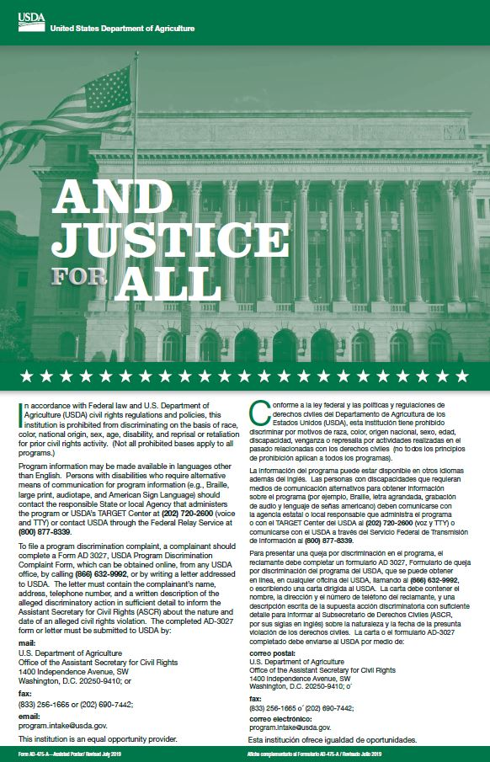
Poster Requirements
Schools must prominently display the USDA nondiscrimination poster “And Justice for All.”
Mandated size is 11” by 17”
Must be displayed in a prominent place where meals/snacks are served and can be easily seen
Cafeteria
Food carts
Attendance office

Slide 10
USDA Nondiscrimination Statement
Agencies must include the most current version of the federal nondiscrimination statement in a prominent location, as well as all:
Public information releases
Publications
Posters concerning nutrition program activities

Slide 11
USDA Nondiscrimination Statement, cont’d.
In accordance with Federal civil rights law and U.S. Department of Agriculture (USDA) civil rights regulations and policies, this institution is prohibited from discriminating on the basis of race, color, national origin, sex, age, disability, and reprisal or retaliation for prior civil rights activity. (Not all prohibited bases apply to all programs.)
Program information may be made available in languages other than English. Persons with disabilities who require alternative means of communication for program information (e.g., Braille, large print, audiotape, and American Sign Language) should contact the responsible State or local Agency that administers the program or USDA’s TARGET Center at (202) 720-2600 (voice and TTY) or contact USDA through the Federal Relay Service at (800)877-8339.
To file a program discrimination complaint, a complainant should complete a Form AD 3027, USDA Program Discrimination Complaint Form, which can be obtained online, from any USDA office, by calling (866) 632-9992, or by writing a letter addressed to USDA. The letter must contain the complainant’s name, address, telephone number, and a written description of the alleged discriminatory action in sufficient detail to inform the Assistant Secretary for Civil Rights (ASCR) about the nature and date of an alleged civil rights violation. The completed AD-3027 form or letter must be submitted to USDA by:
(1) mail: U.S. Department of Agriculture
Office of the Assistant Secretary for Civil Rights
1400 Independence Avenue, SW
Washington, D.C. 20250-9410; or
fax: (833) 256-1665 or (202) 690-7442;
email: program.intake@usda.gov.
This institution is an equal opportunity provider.

Slide 12
Short Nondiscrimination Statement
An abbreviated statement can be used on smaller print materials such as: flyers, brochures, and menus.
If this statement is used:
Print size cannot be smaller than that used for the program material
No other modifications can be made to these statements
“This institution is an equal opportunity provider. ”

Slide 13
Racial & Ethnic Data
Racial and ethnic data must be collected in the service area to determine how effectively the meal programs are reaching potentially eligible students.
If a meal application does not indicate racial or ethnic information, the data shall be collected through the District's data collection.
Record and Secure the information
Retain information for three years plus the current year

Slide 14
What is Discrimination?
“The practice of unfairly treating a person or group of people differently from other people or groups of people.” -Merriam-Webster dictionary
USDA Programs prohibit discrimination based on:
Race, national origin, age, color, religious creed, political beliefs, sex, disability, or reprisal or retaliation for prior civil rights activity in any program or activity conducted or funded by USDA.

Slide 15
Reasonable Accommodations
Reasonable accommodations means that participants must be able to have equal access to all areas related to the child nutrition programs.
The Americans with Disabilities Amendment Act requires that sponsors provide:
Substitutions to a child with a disability when the need is supported by a written medical statement
A “Medical Statement to Request a Special Diet” must be completed and signed by a medical authority

Slide 16
Training Requirements
Annual training on civil rights-related laws, regulations, and procedures is required. Sponsors must provide:
Annual training for their personnel
Documentation that the civil rights training occurred, the topics covered, and a list of the participants that attended
Notes:
TELL: Similar to your required training, annual training on civil rights-related laws, regulations, and procedures is required for staff involved in all levels of the child nutrition program administration, including those responsible for compliance. Sponsors must provide annual training for their personnel, including frontline staff. Sponsors are required to provide documentation that the civil rights training occurred, including the topics covered, and a list of the participants that attended.

Slide 17
Civil Rights
Complaint Procedures
SFAs are required to comply with civil rights complaint procedures. Sponsors must:
Appoint a civil rights coordinator to address complaints
Monica Dudley, Food Services Regional Manager
Establish a grievance procedure for handling complaints
Train and implement procedures to determine and process civil rights complaints
Provide information of requirements and procedures for filing a complaint in English or the appropriate language

Slide 18
How To File A Complaint
To file a program complaint of discrimination, complete the USDA Program Discrimination Complaint Form, (AD-3027) found online at: How to File a Complaint, and at any USDA office, or write a letter addressed to USDA and provide in the letter all of the information requested in the form. To request a copy of the complaint form, call (866) 632-9992. Submit your completed form or letter to USDA by:
Mail: U.S. Department of Agriculture Office of the Assistant Secretary for Civil Rights 1400 Independence Avenue, SW Washington, D.C. 20250-9410;
Fax: (833) 256-1665 or (202) 690-7442
Email: program.intake@usda.gov.

Slide 19
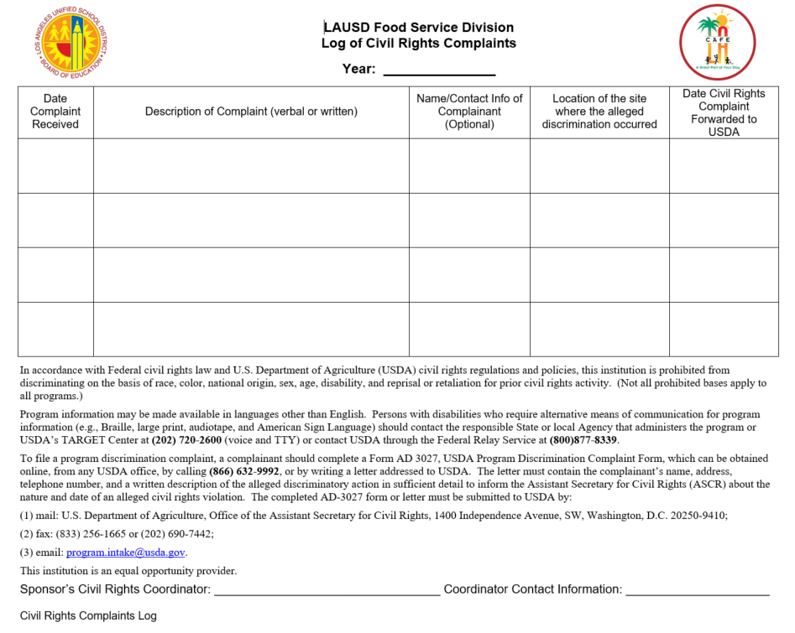
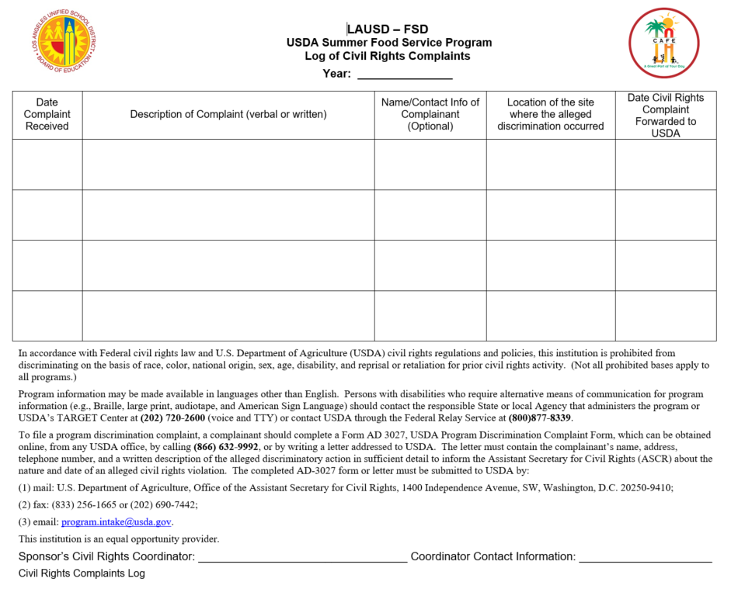
Civil Rights Complaint Log
The USDA will inform SFAs when civil rights complaints are received. LAUSD is required to maintain a log of any such complaints. A separate log is used in the summer.
Food Service Division Log
Summer Food Service Program Log

Slide 20
Civil Rights Resources
CDE USDA Civil Rights and Complaints web page
CDE Civil Rights and Complaints Handbook
USDA Civil Rights and Complaints - Nutrition (CA Dept of Education)

